Slide 1



CLASS 5 CUSTOMER SEGMENTATION DASHBOARD
View in Power BI
Last data refresh:
11/09/2025 18:03:36 UTC
Downloaded at:
13/09/2025 17:39:29 UTC

Slide 2
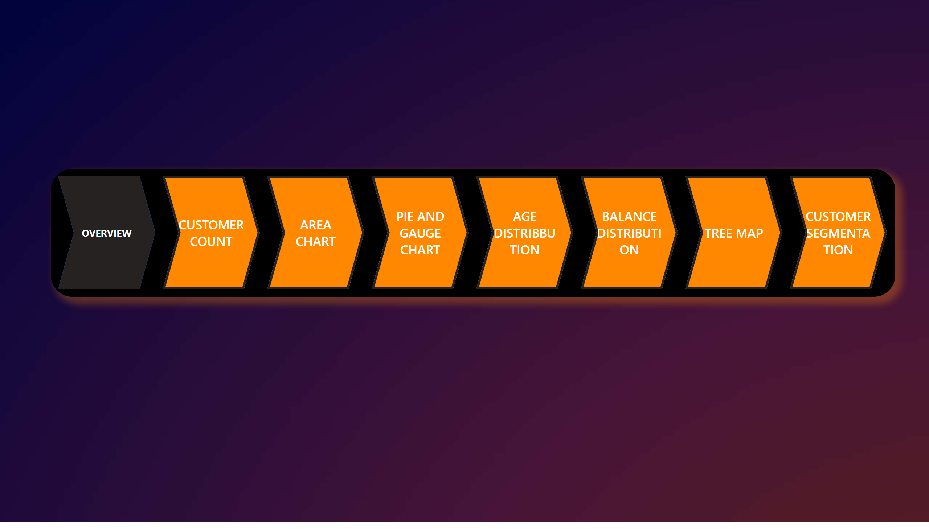
OVERVIEW
Notes:
pageNavigator
No alt text provided

Slide 3
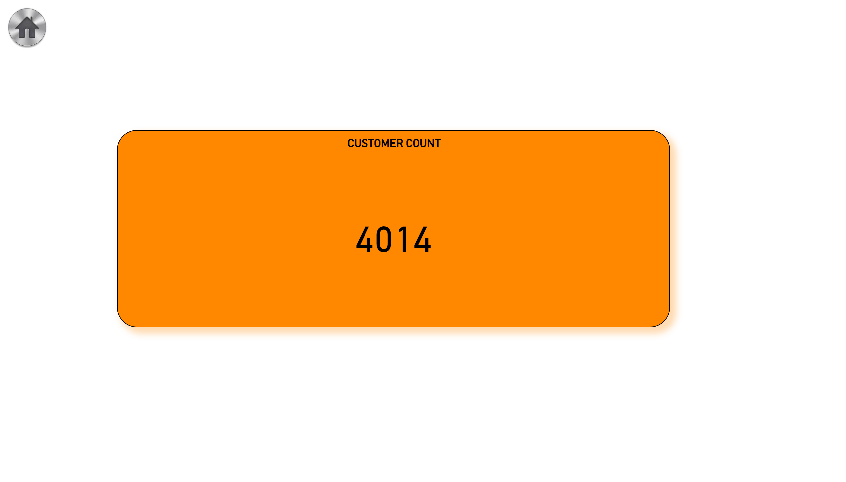
CUSTOMER COUNT
Notes:
CUSTOMER COUNT
No alt text provided
image
No alt text provided

Slide 4
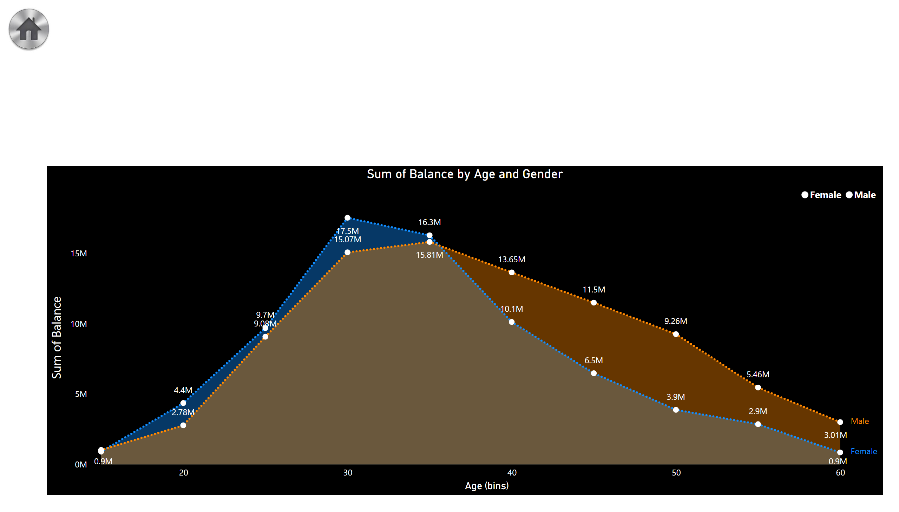
AREA CHART
Notes:
Sum of Balance by Age and Gender
No alt text provided
image
No alt text provided

Slide 5
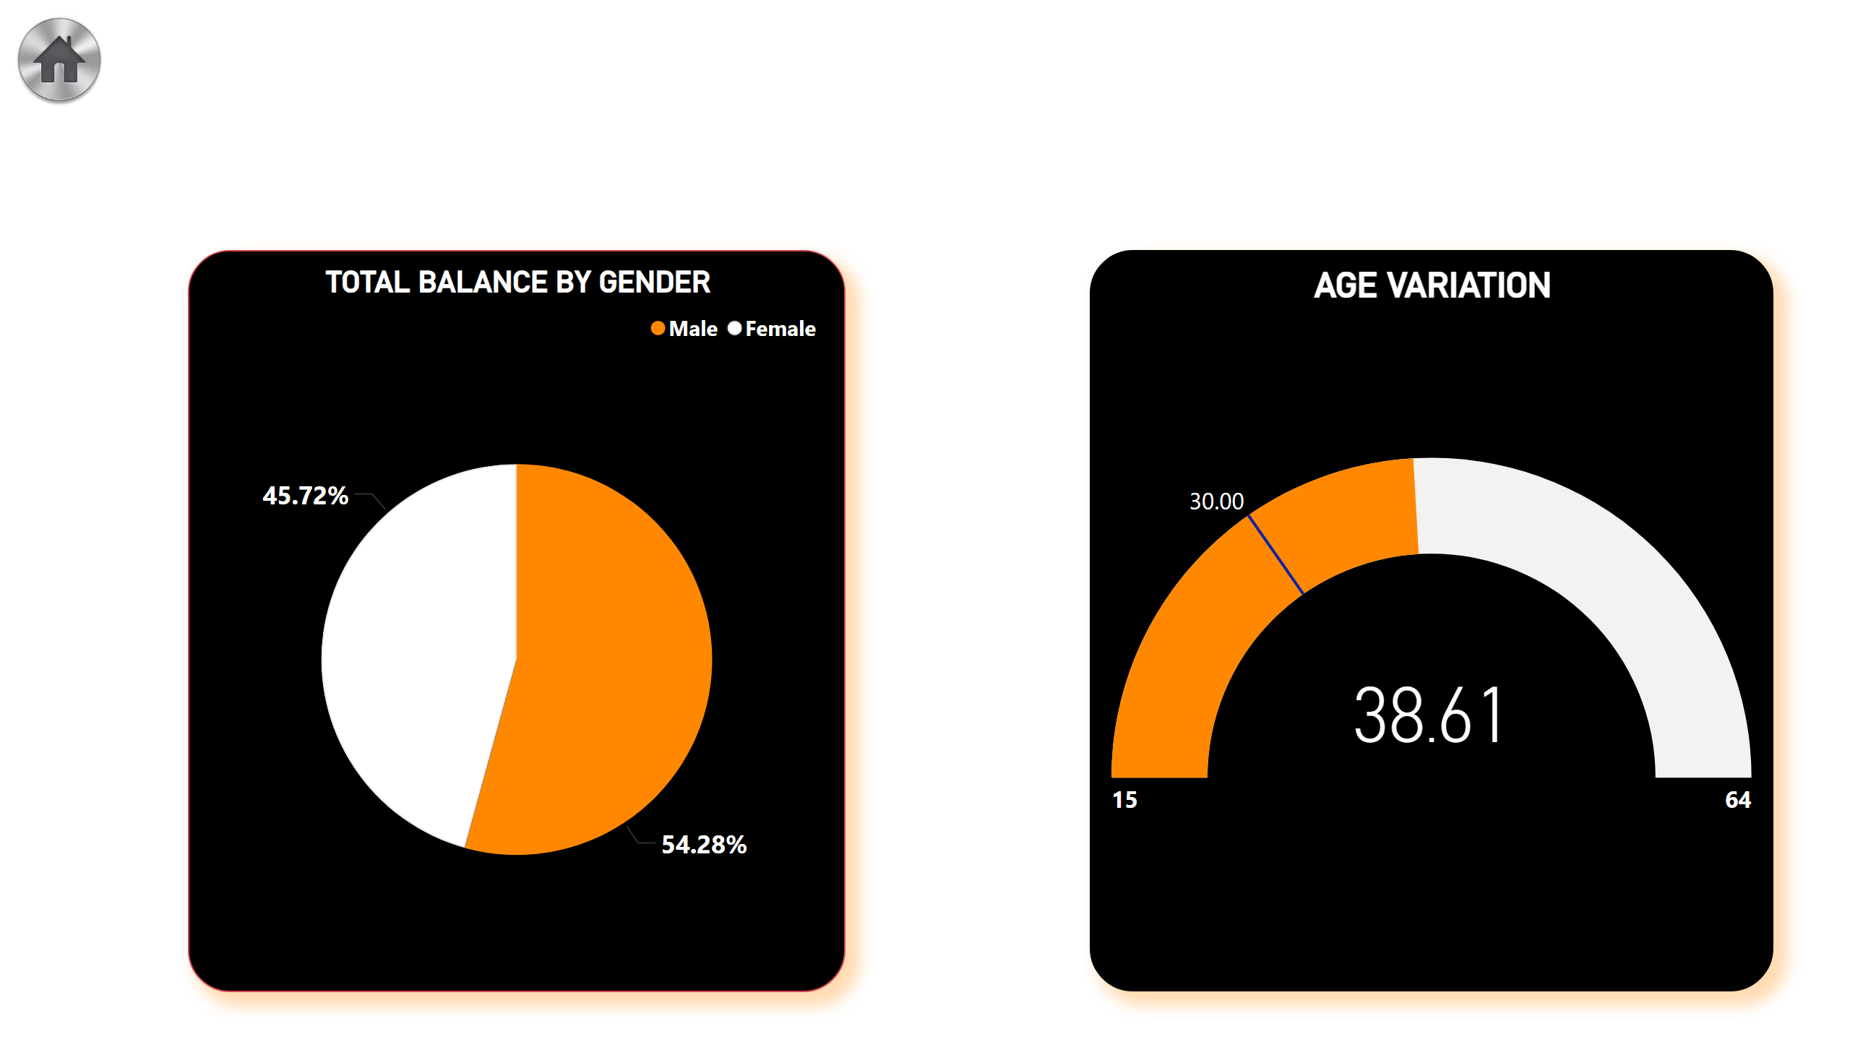
PIE AND GAUGE CHART
Notes:
AGE VARIATION
No alt text provided
TOTAL BALANCE BY GENDER
No alt text provided
image
No alt text provided

Slide 6
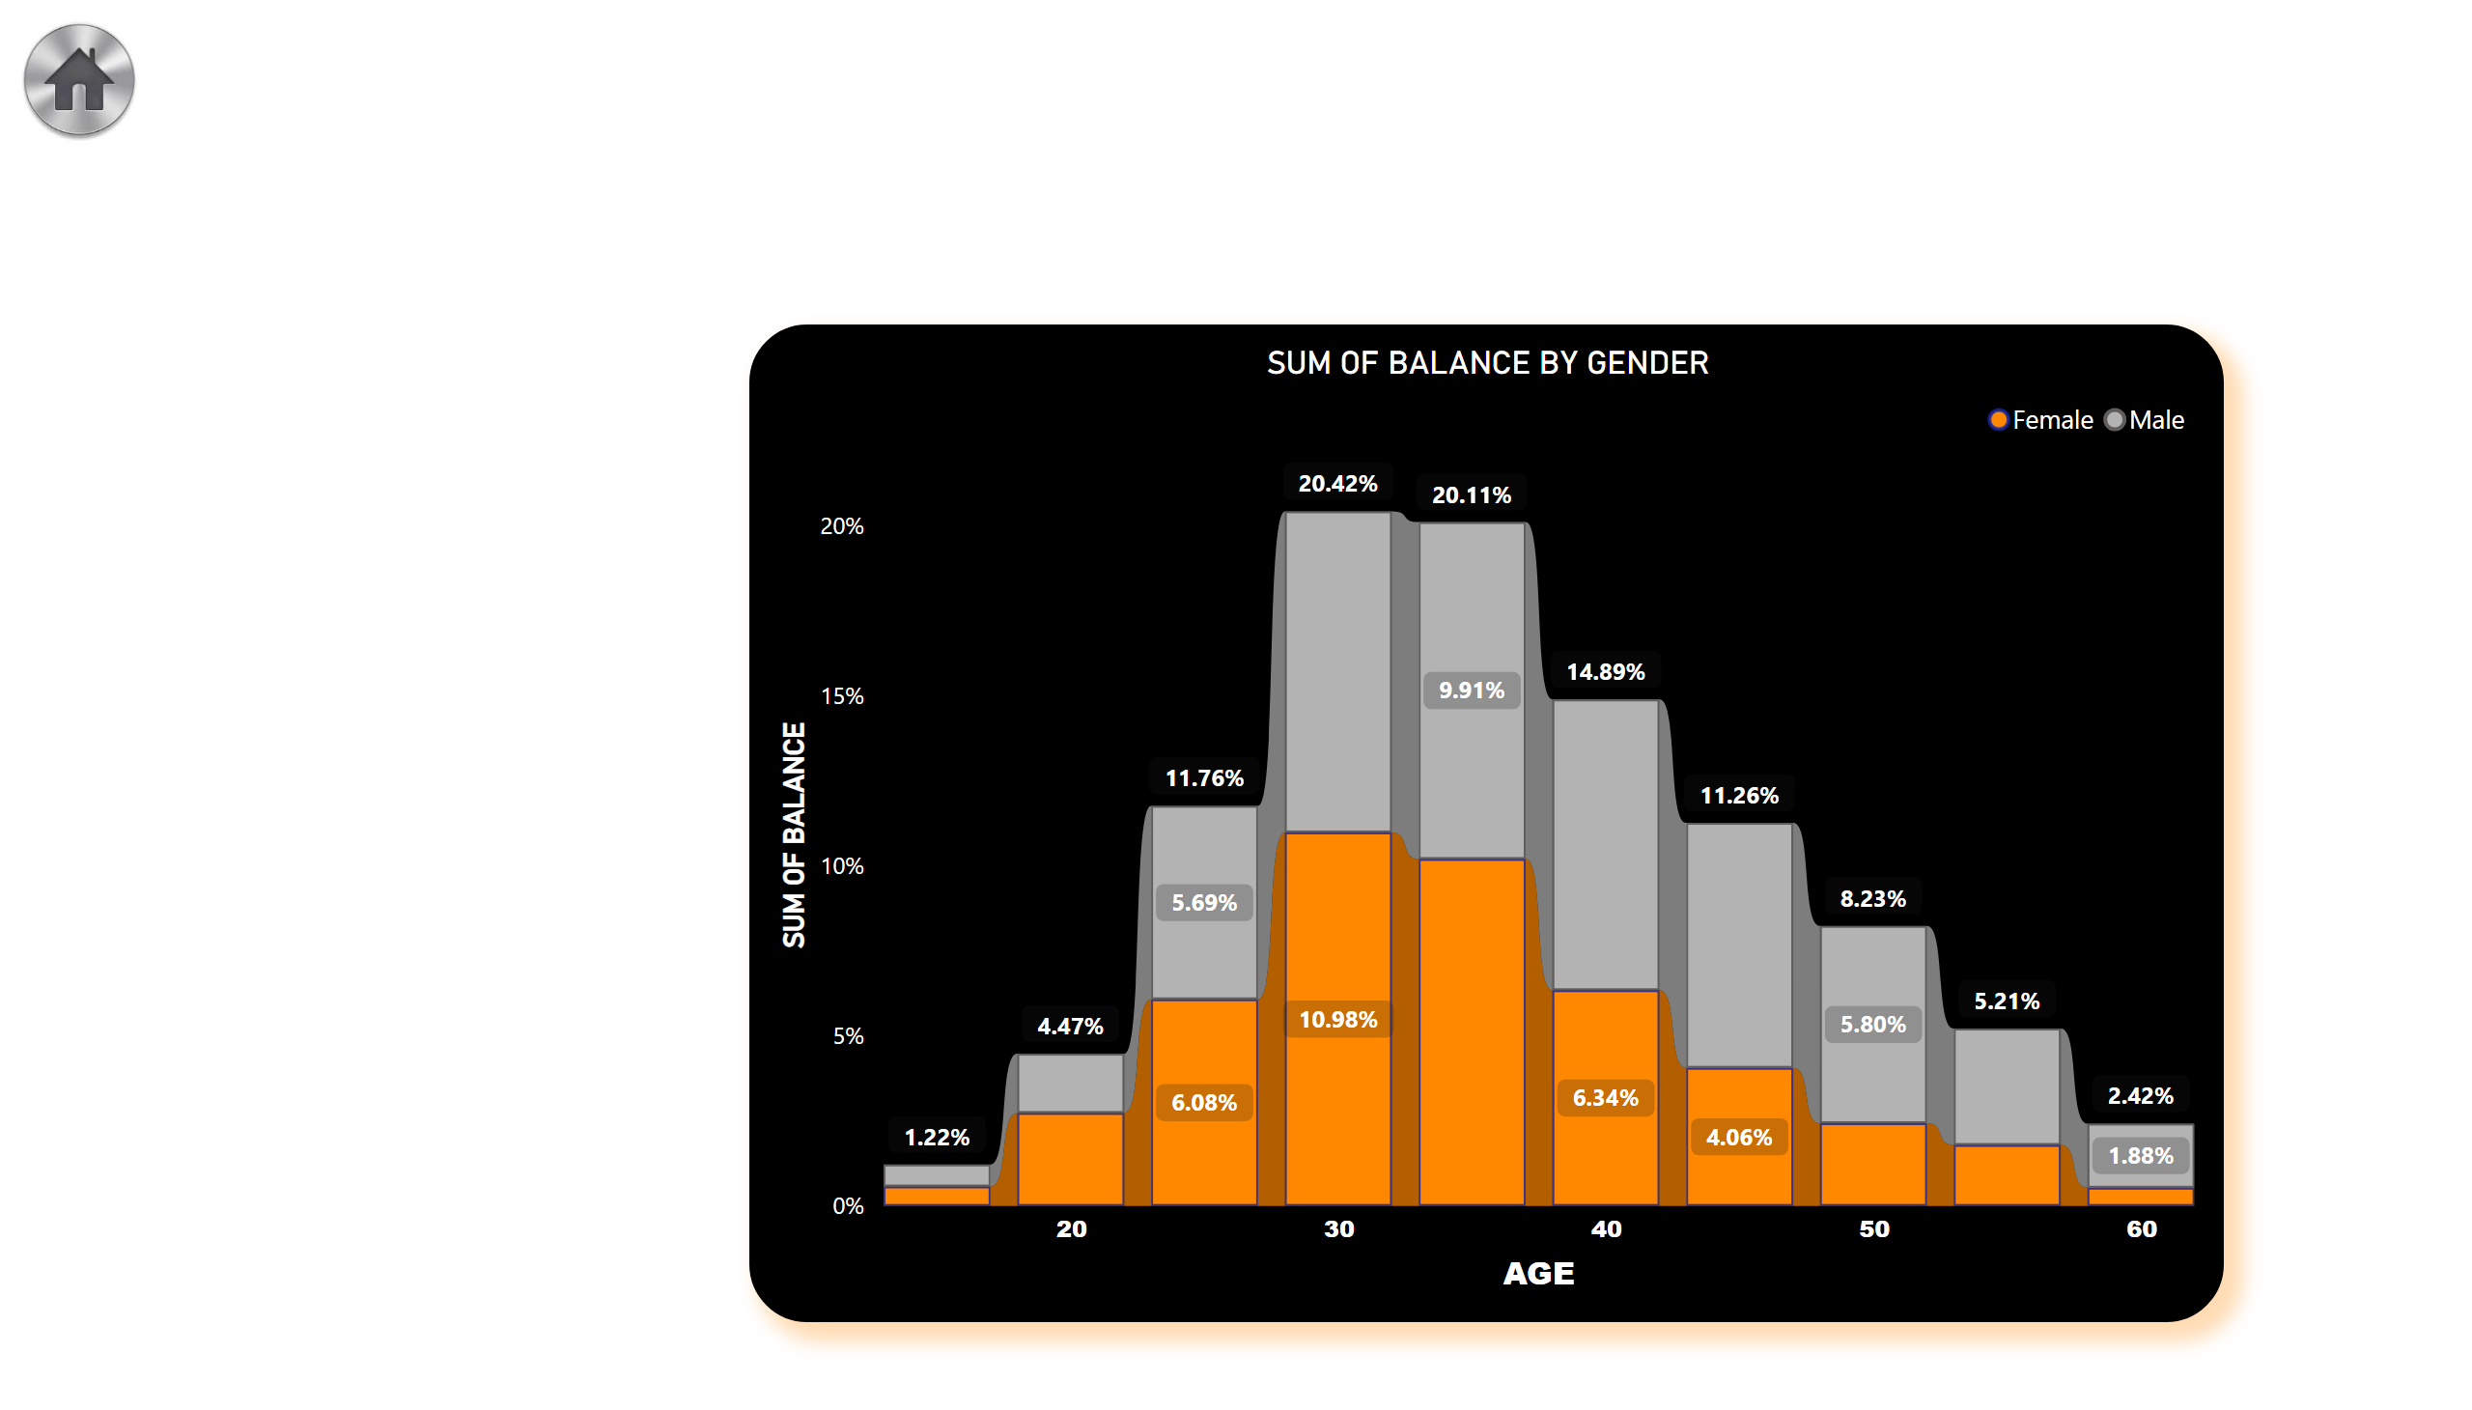
AGE DISTRIBBUTION
Notes:
SUM OF BALANCE BY GENDER
No alt text provided
image
No alt text provided

Slide 7
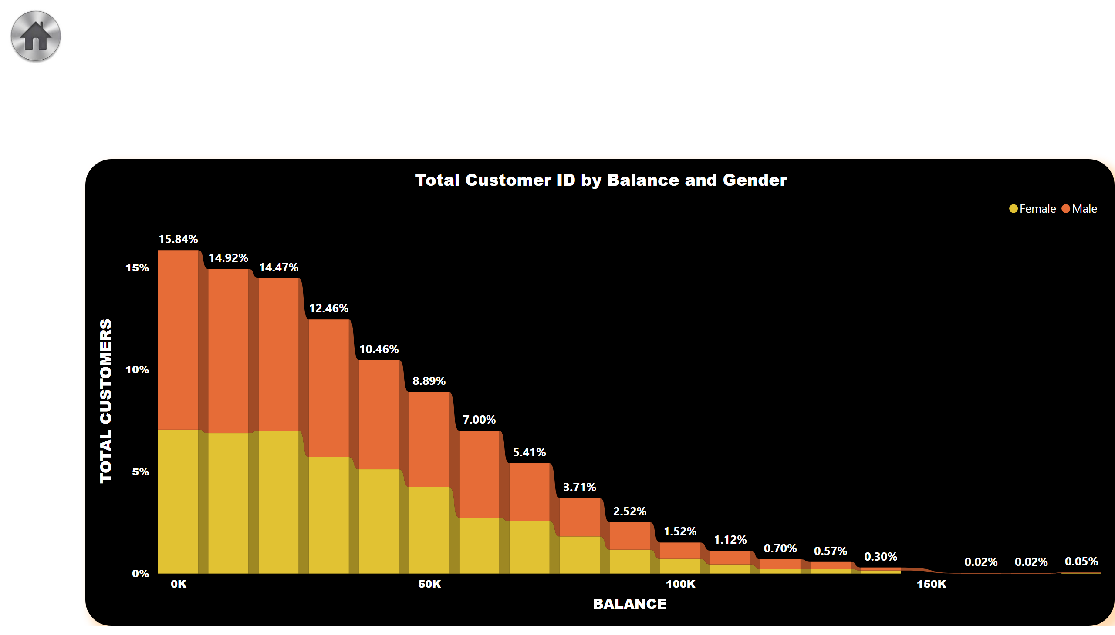
BALANCE DISTRIBUTION
Notes:
Total Customer ID by Balance and Gender
No alt text provided
image
No alt text provided

Slide 8
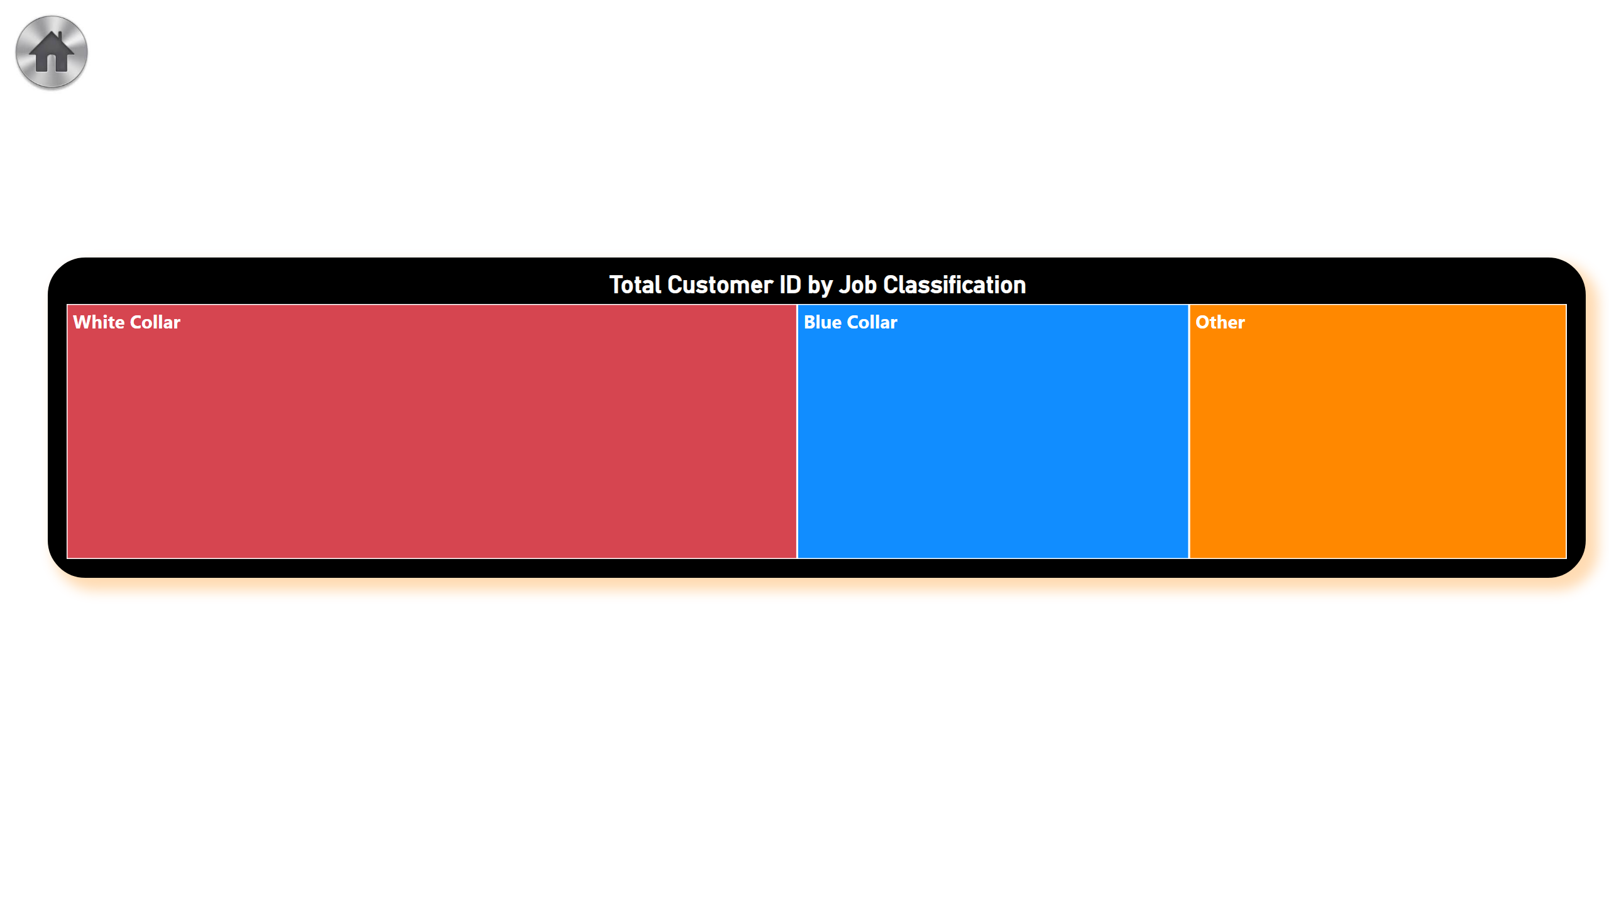
TREE MAP
Notes:
Total Customer ID by Job Classification
No alt text provided
image
No alt text provided

Slide 9
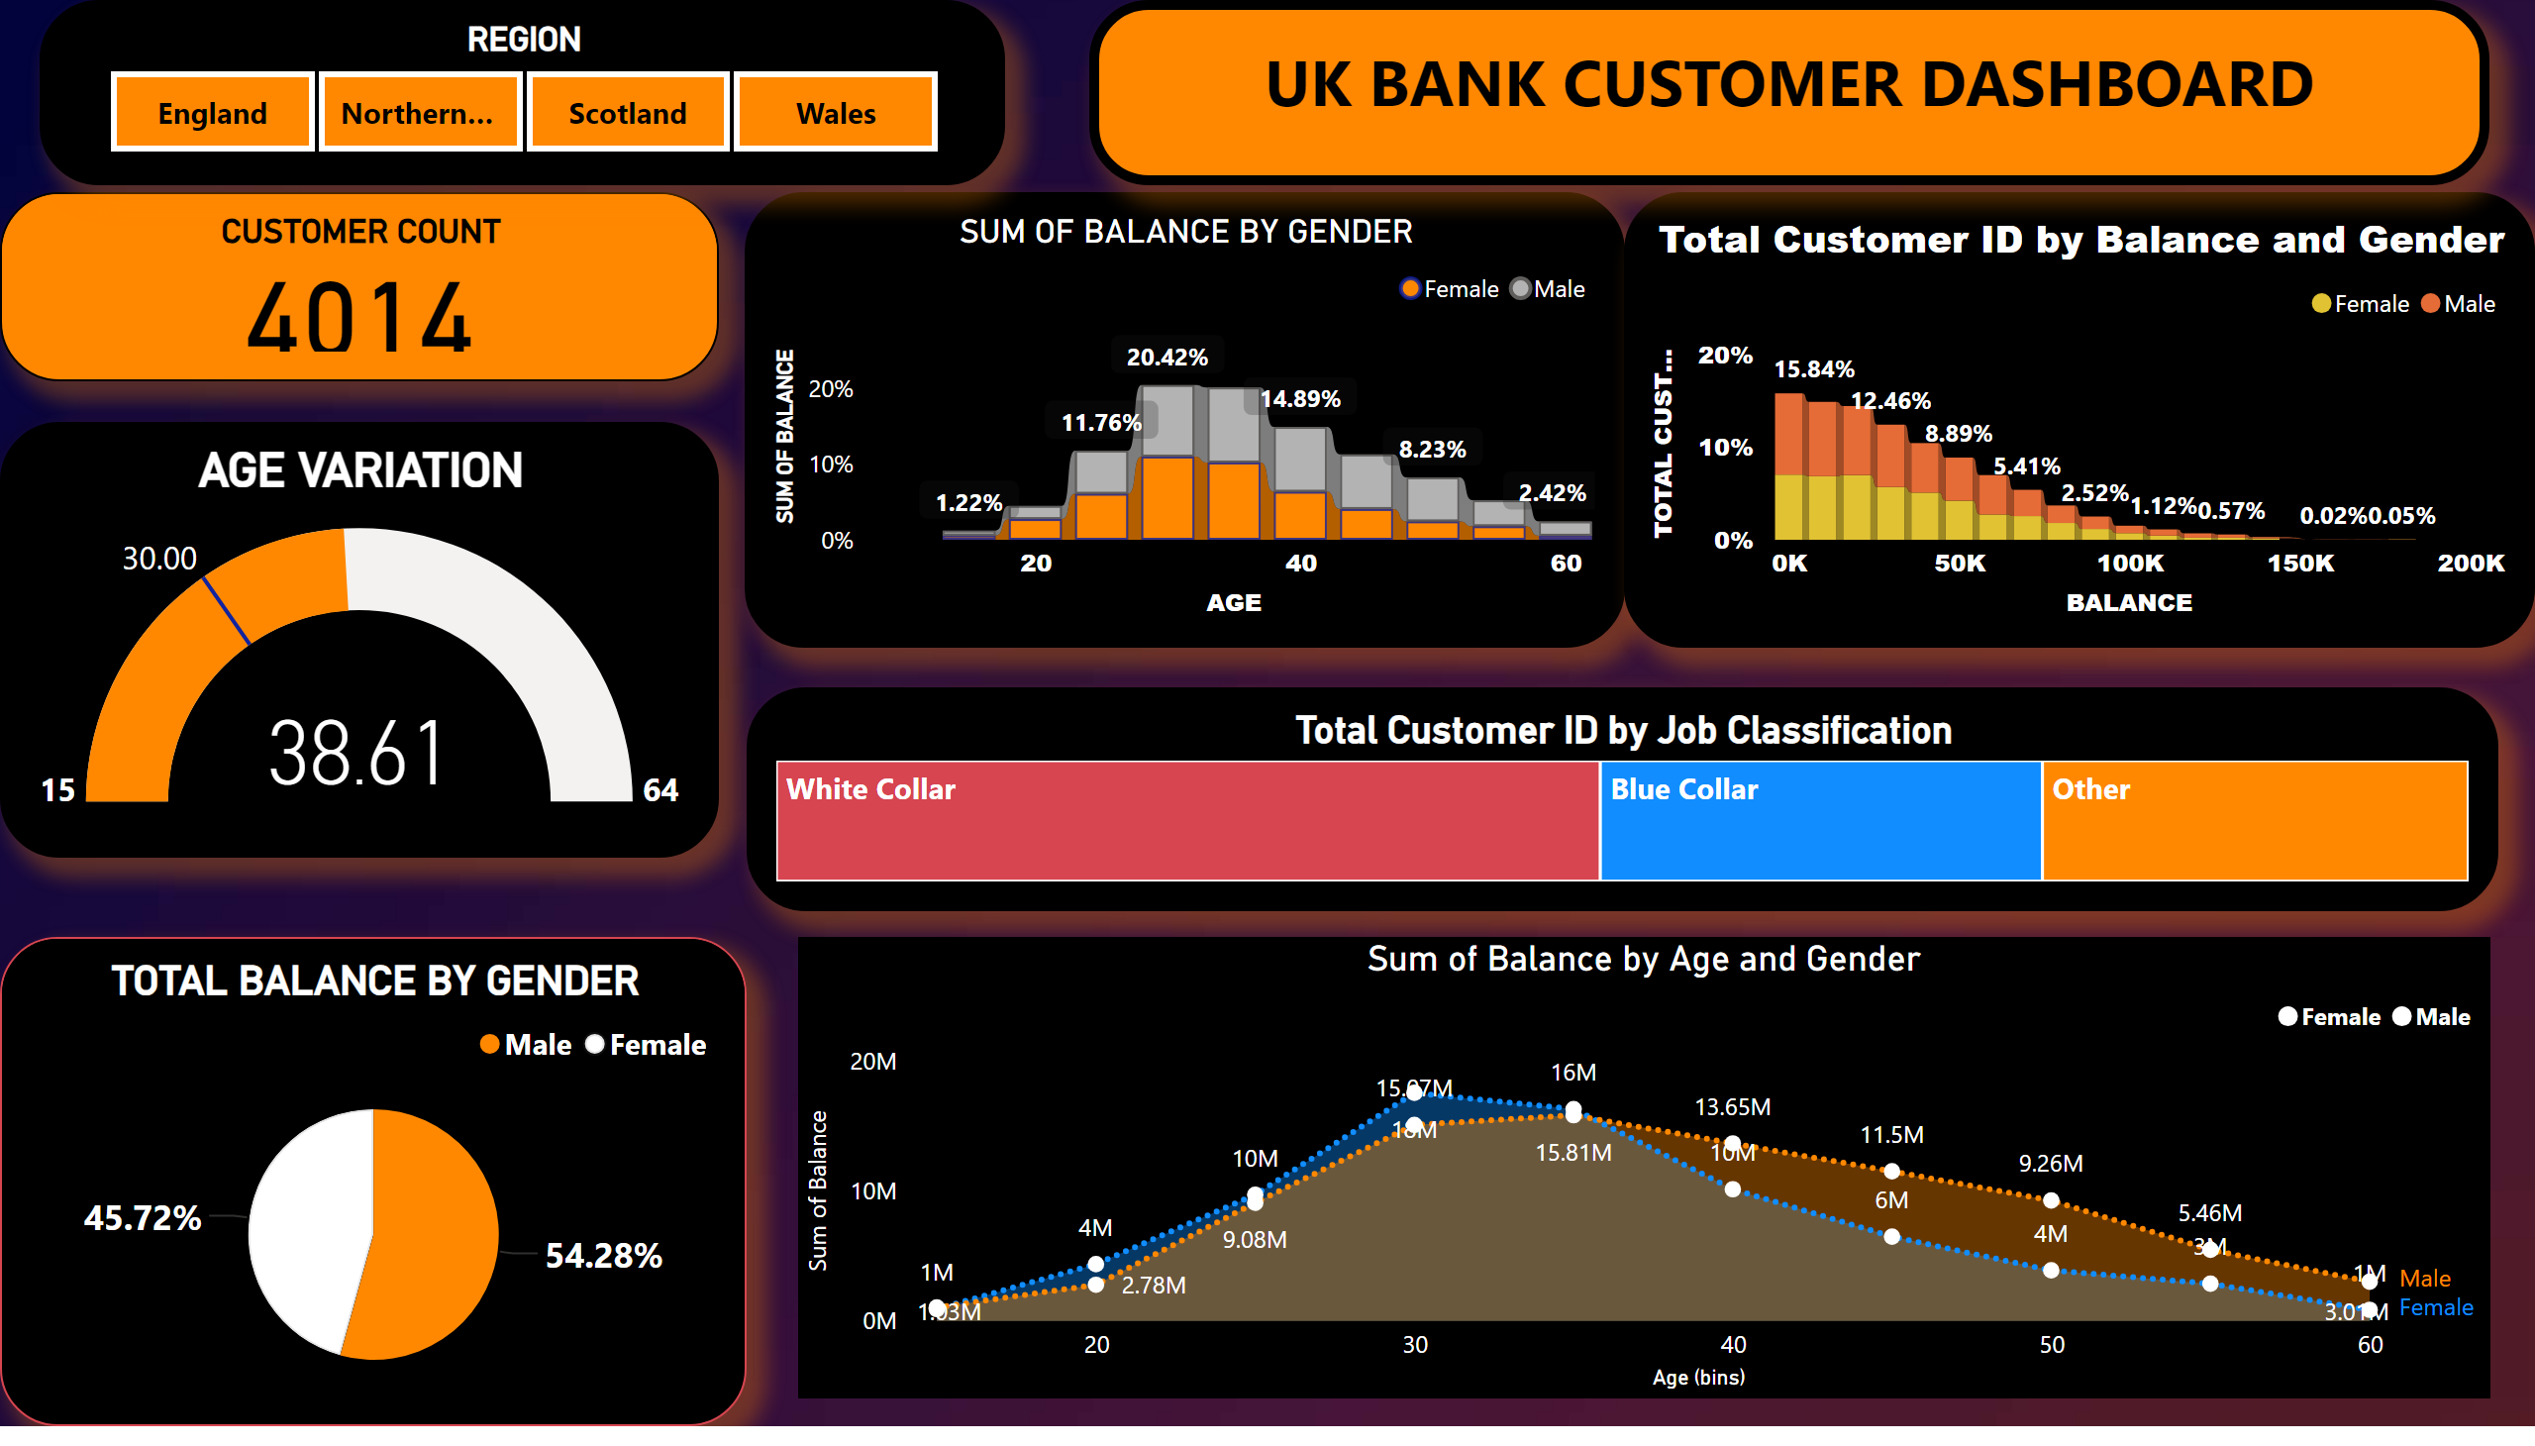
CUSTOMER SEGMENTATION
Notes:
CUSTOMER COUNT
No alt text provided
TOTAL BALANCE BY GENDER
No alt text provided
AGE VARIATION
No alt text provided
SUM OF BALANCE BY GENDER
No alt text provided
Total Customer ID by Balance and Gender
No alt text provided
Total Customer ID by Job Classification
No alt text provided
textbox
No alt text provided
REGION
No alt text provided
Sum of Balance by Age and Gender
No alt text provided

